Slide 1

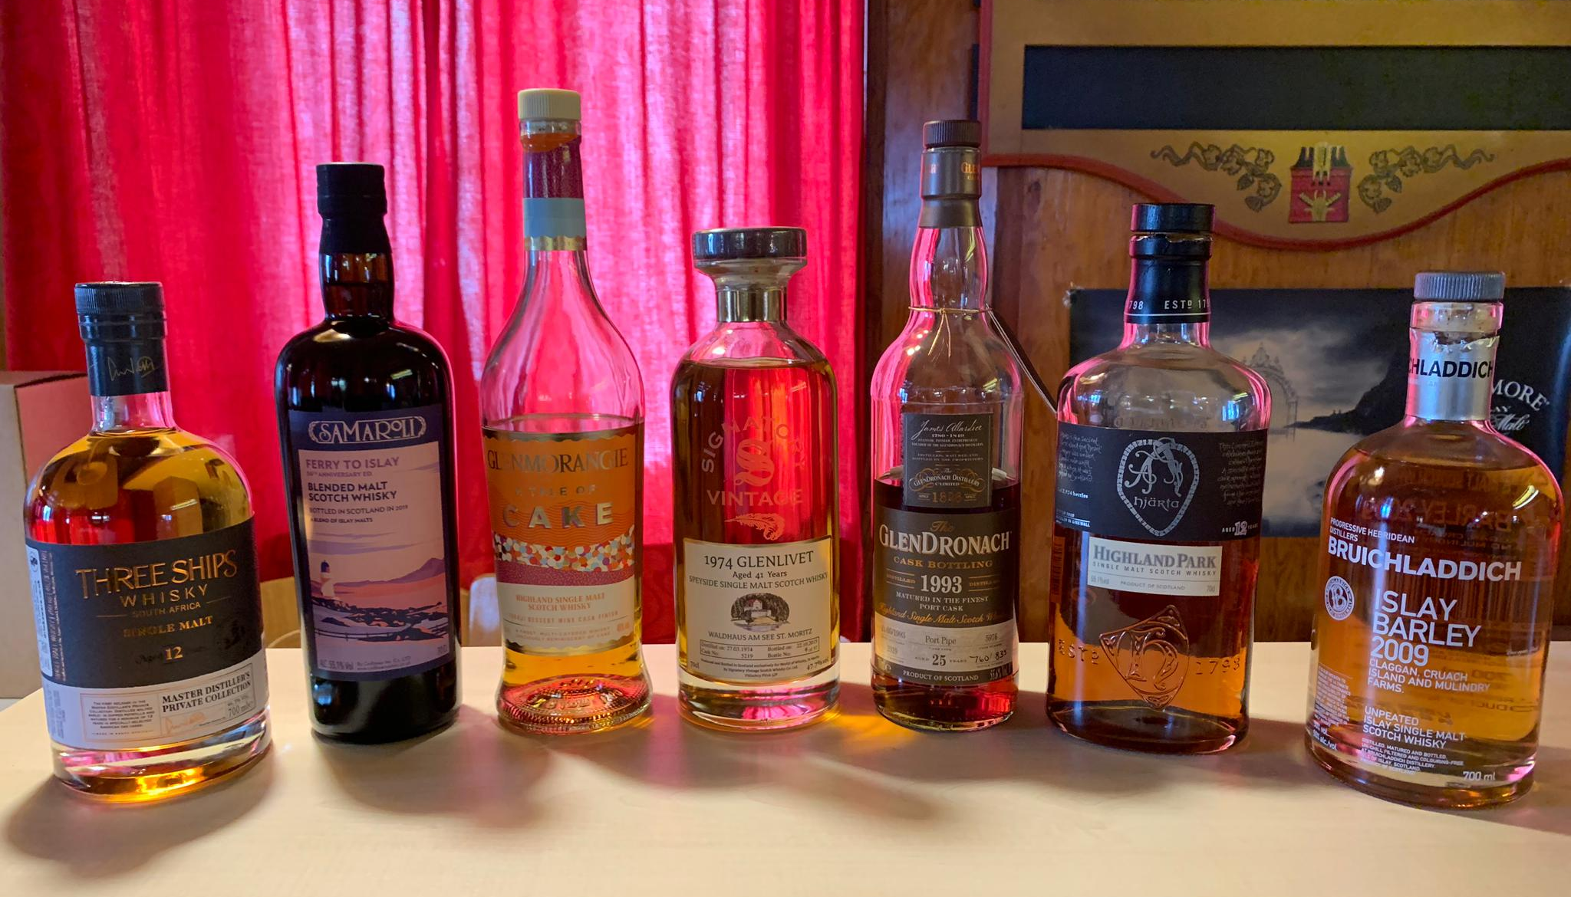
SEVENTEEN DRAMS
ONLINE TASTING 12. Januar 2021

Slide 2
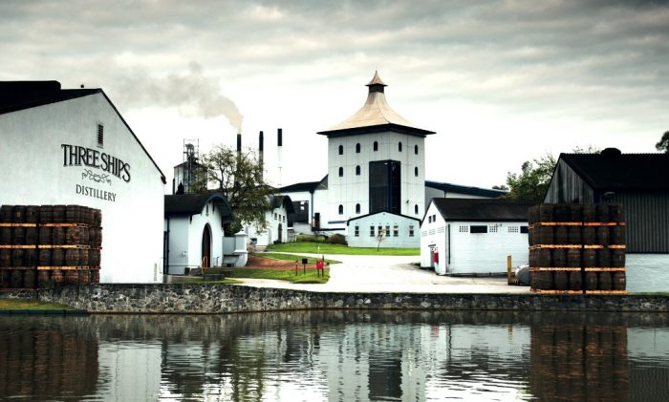
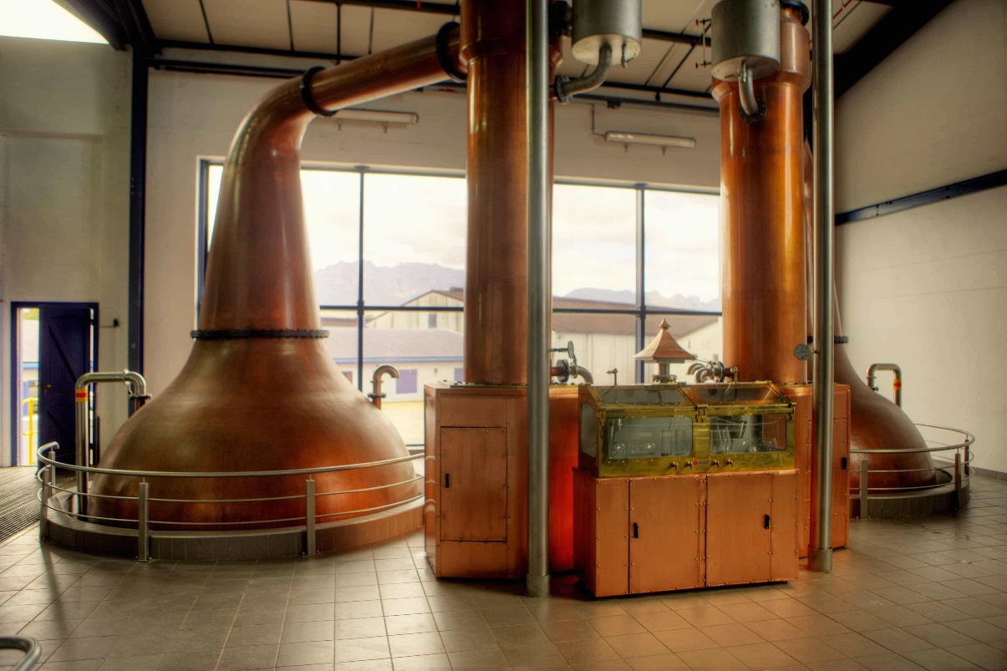
SEVENTEEN DRAMS
James sedwick distillery estd. 1886 Wellington, südafrika

Slide 3
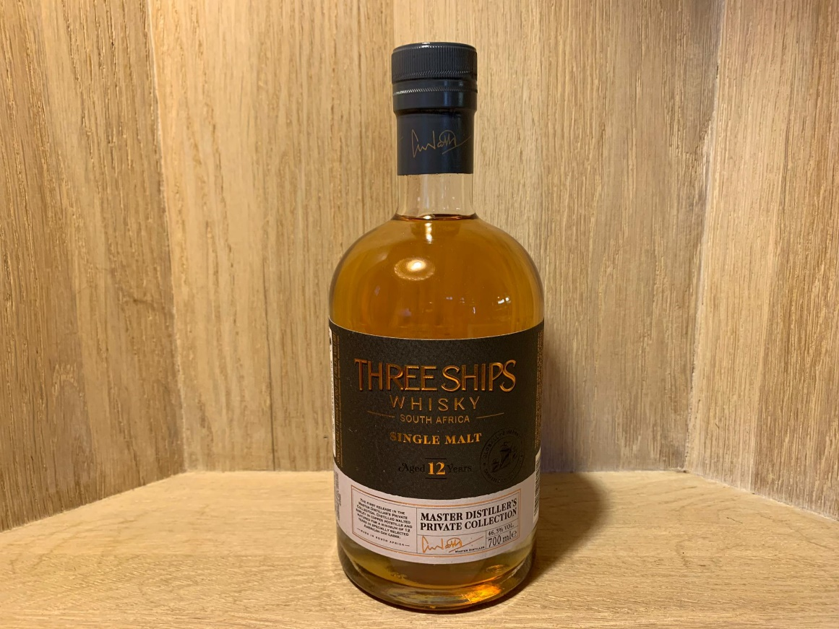
SEVENTEEN DRAMS
Three ships 12yo master Distiller’s Private collection 46.3%

Slide 4
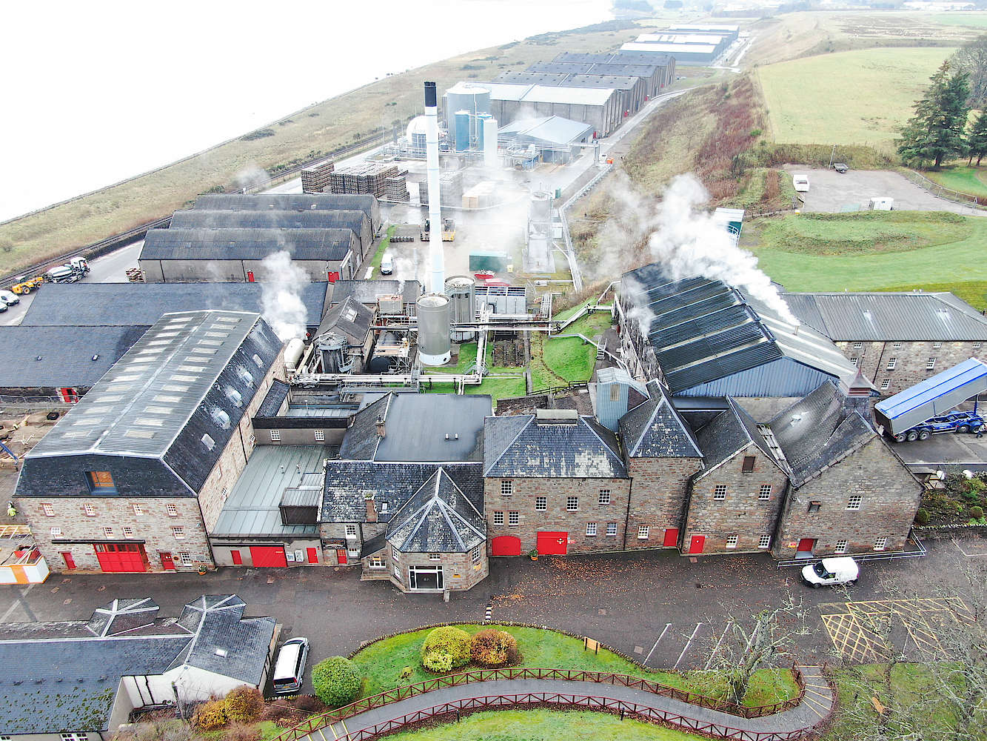
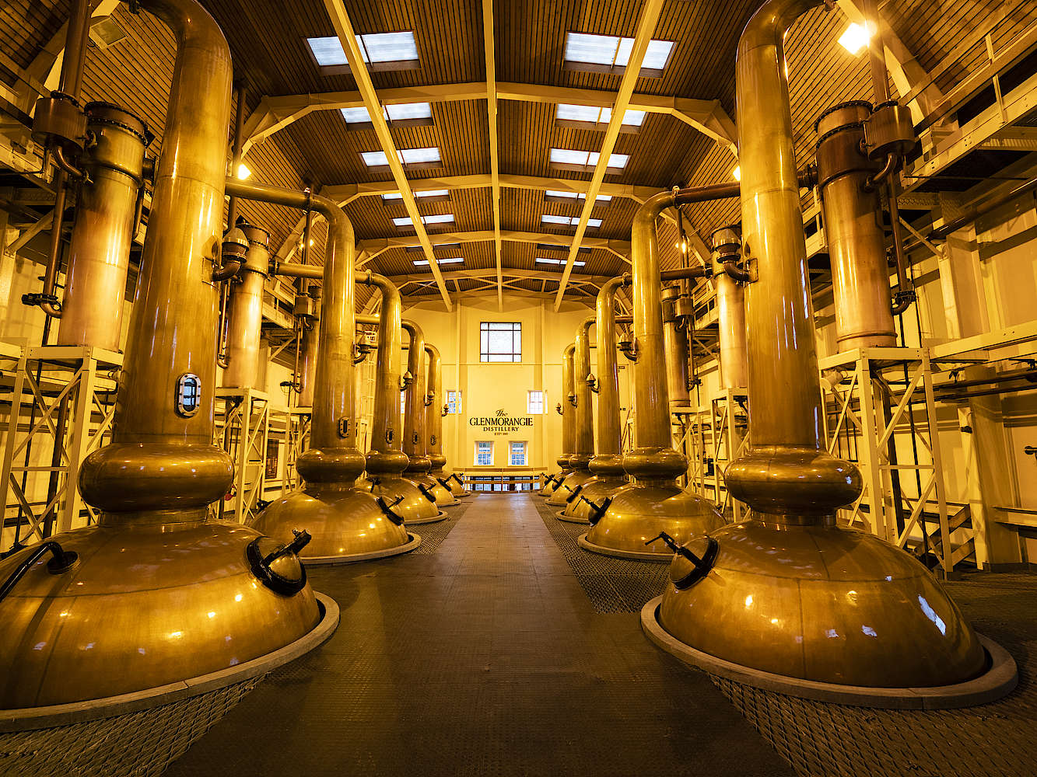
SEVENTEEN DRAMS
glenmorangie Estd. 1843 Northern highlands

Slide 5
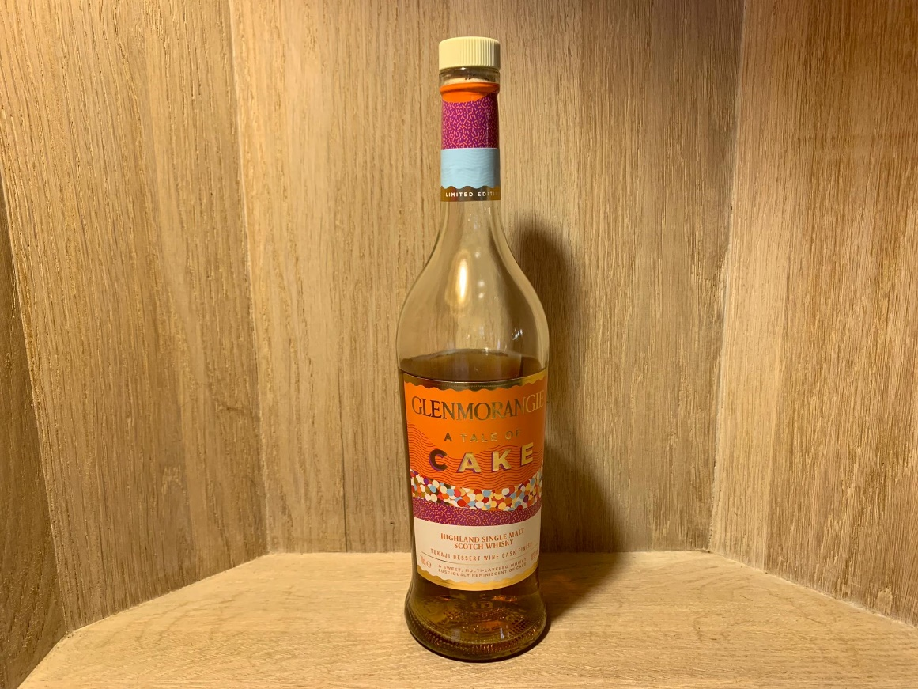
SEVENTEEN DRAMS
glenmorangie «a tale of cake» tokaji dessert wine finish 46%

Slide 6
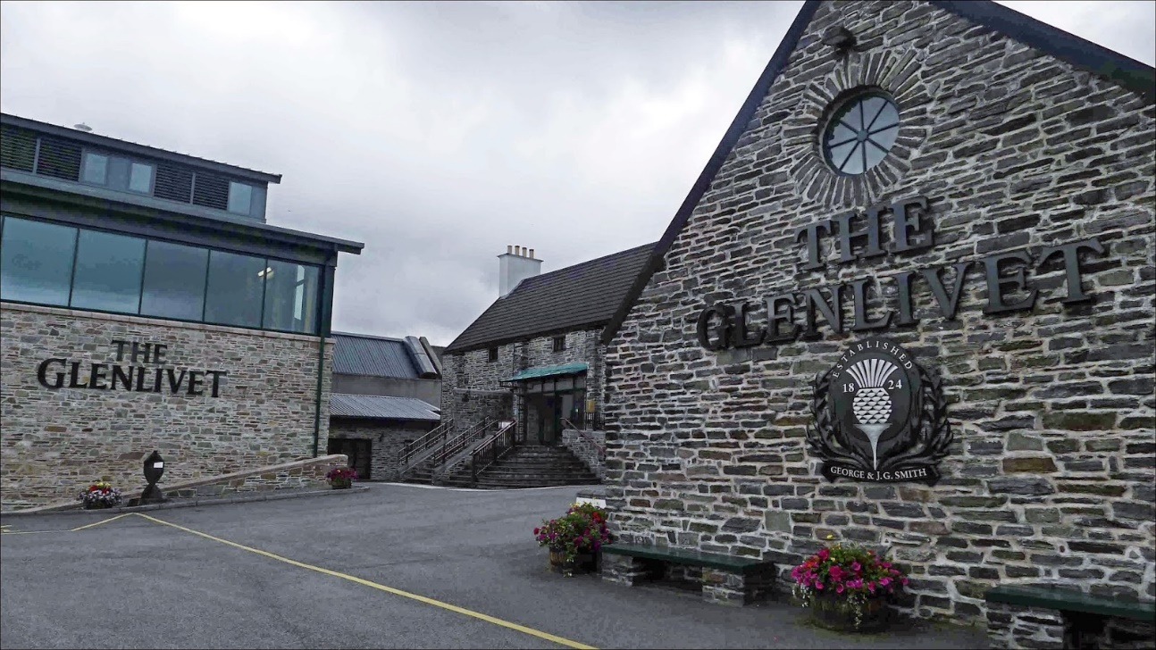
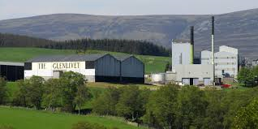
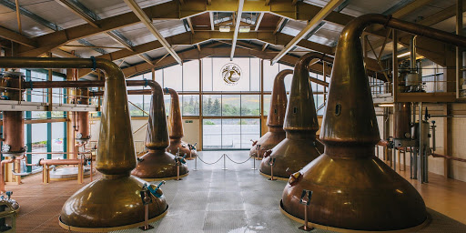
SEVENTEEN DRAMS
glenlivet Estd. 1824 speyside

Slide 7
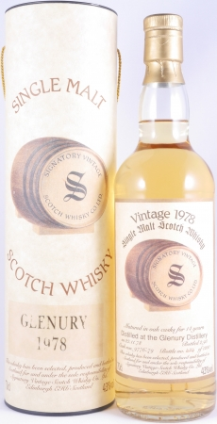
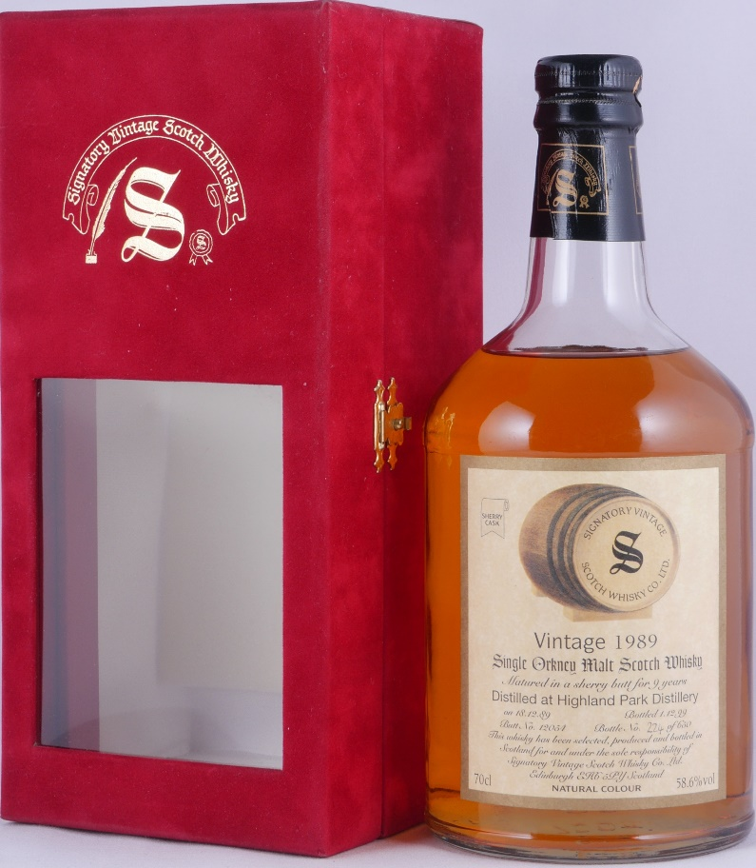
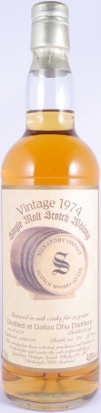

SEVENTEEN DRAMS
signatory Estd. 1988 leith, schottland

Slide 8
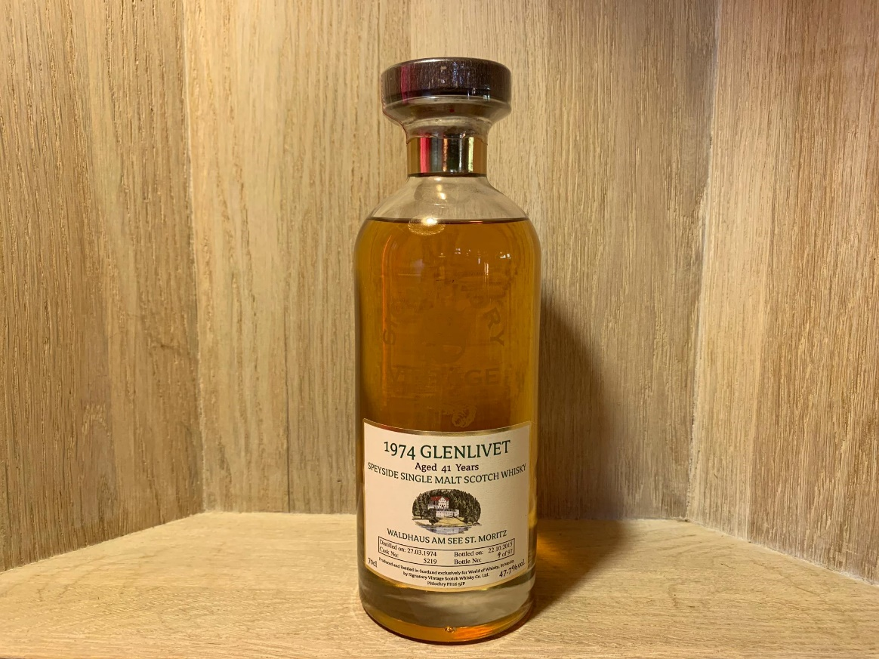
SEVENTEEN DRAMS
Glenlivet 1974 41yo signatory for waldhaus cask no. 5219 bottle 9 of 97 47.7%

Slide 9
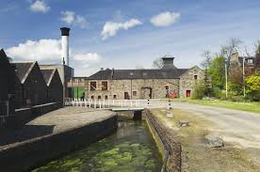
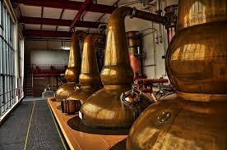
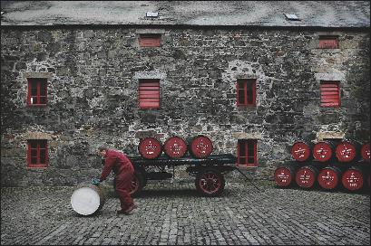
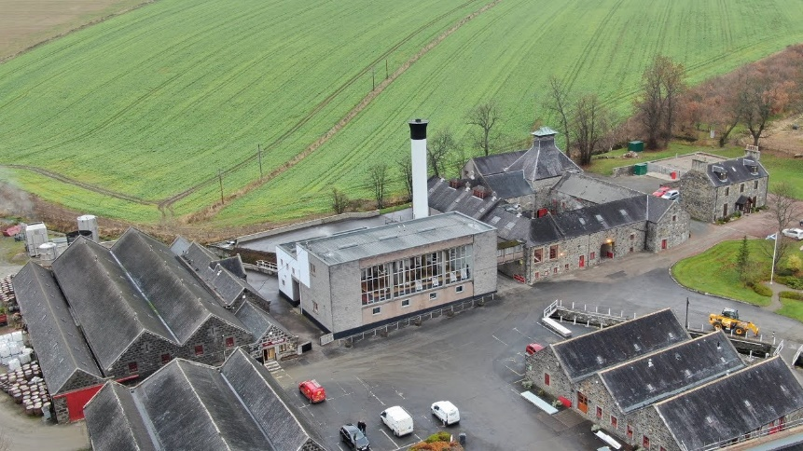
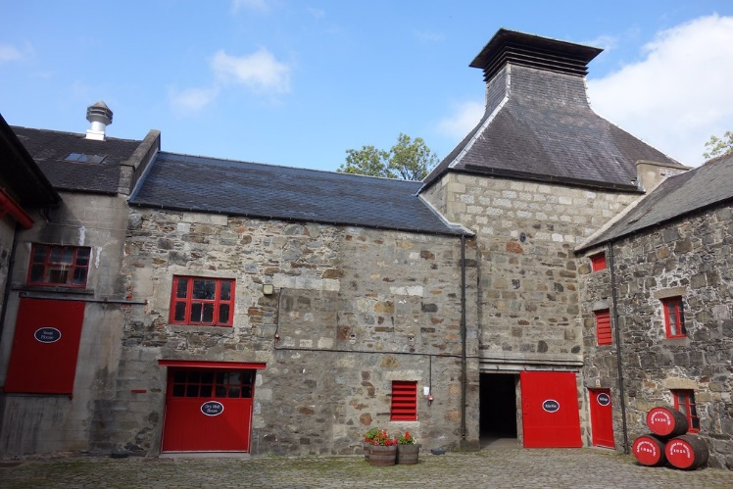
SEVENTEEN DRAMS
glendronach Estd. 1826 Eastern highlands

Slide 10
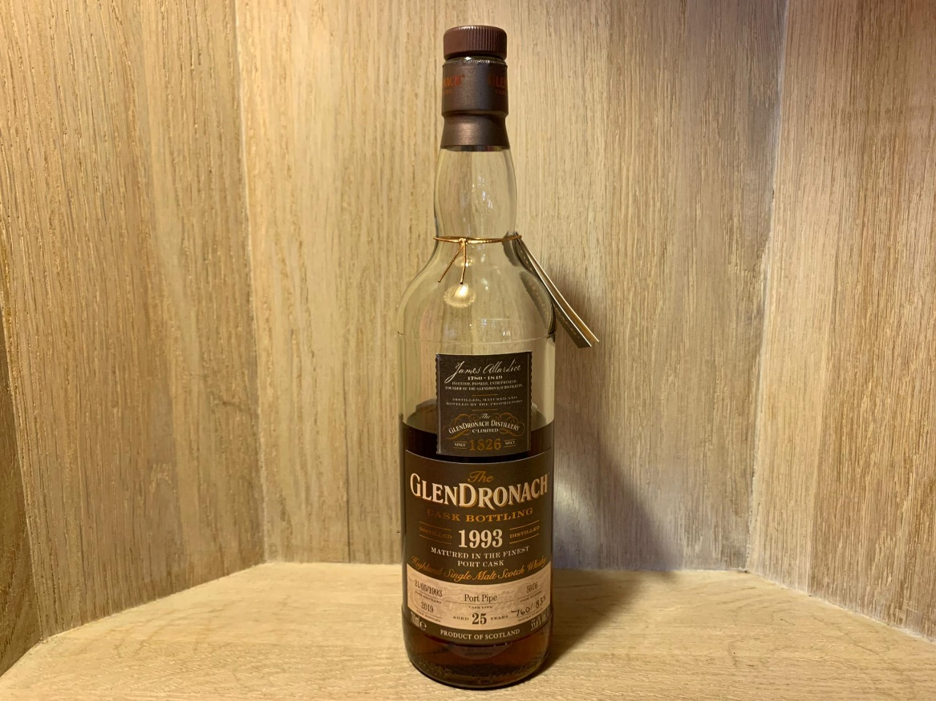
SEVENTEEN DRAMS
GLENDRONACH 25Y 1993/2019 port pipe CASK NO. 5976 Bottle no. 760 of 835 55.6%

Slide 11
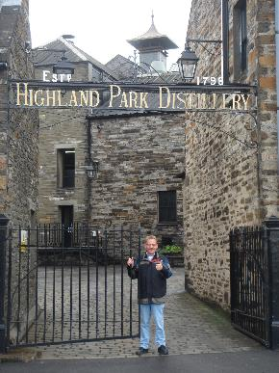
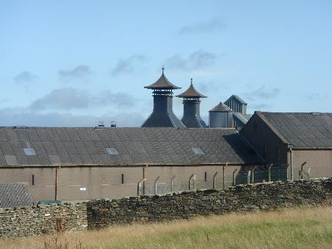
SEVENTEEN DRAMS
Highland park estd. 1798 Isle of orkney

Slide 12
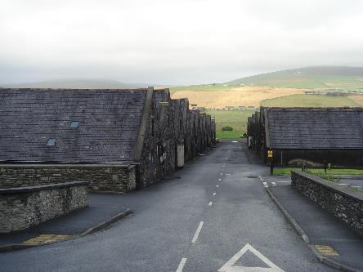
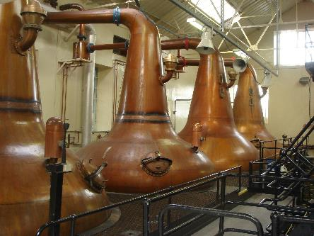
SEVENTEEN DRAMS
Highland park Estd. 1798 Isle of orkney

Slide 13
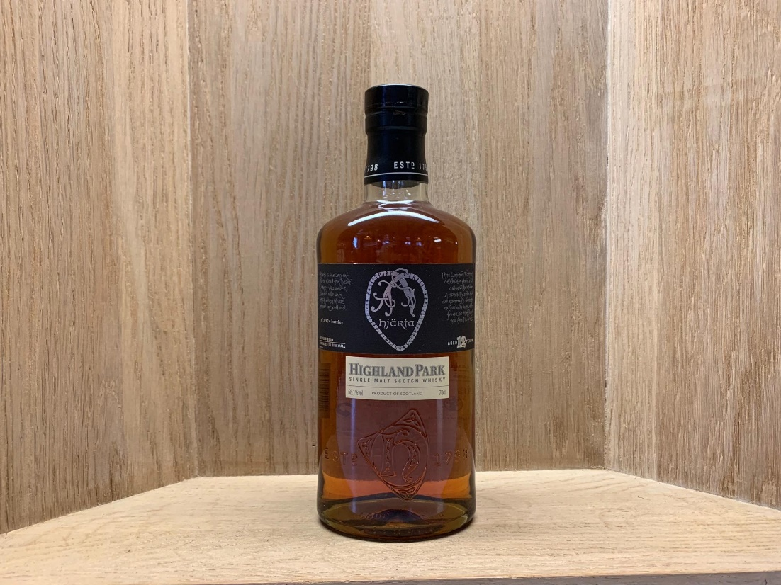
SEVENTEEN DRAMS
Highland park 12yo bottled 2008 hjärta 1 of 3’924 bottles 58.1%

Slide 14
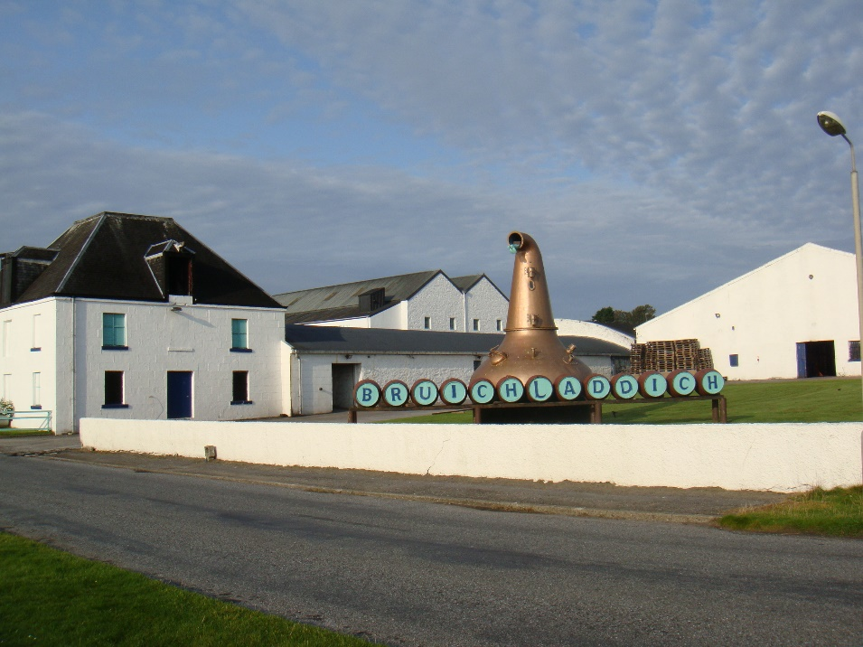
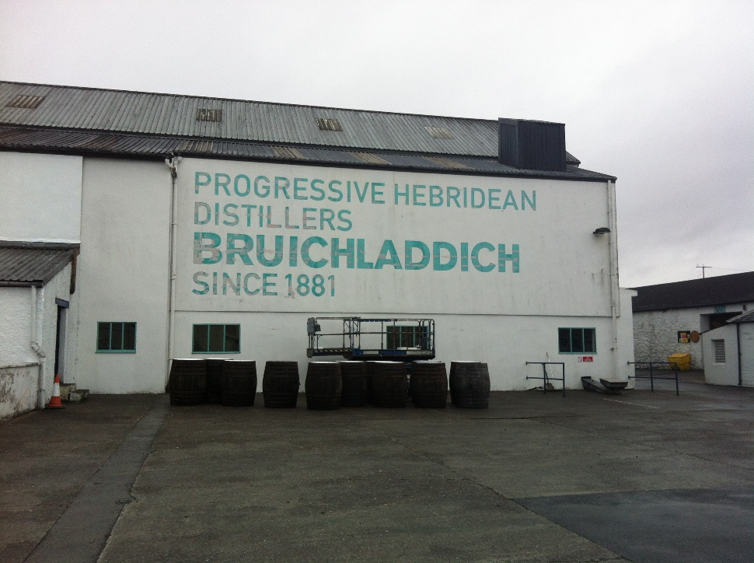
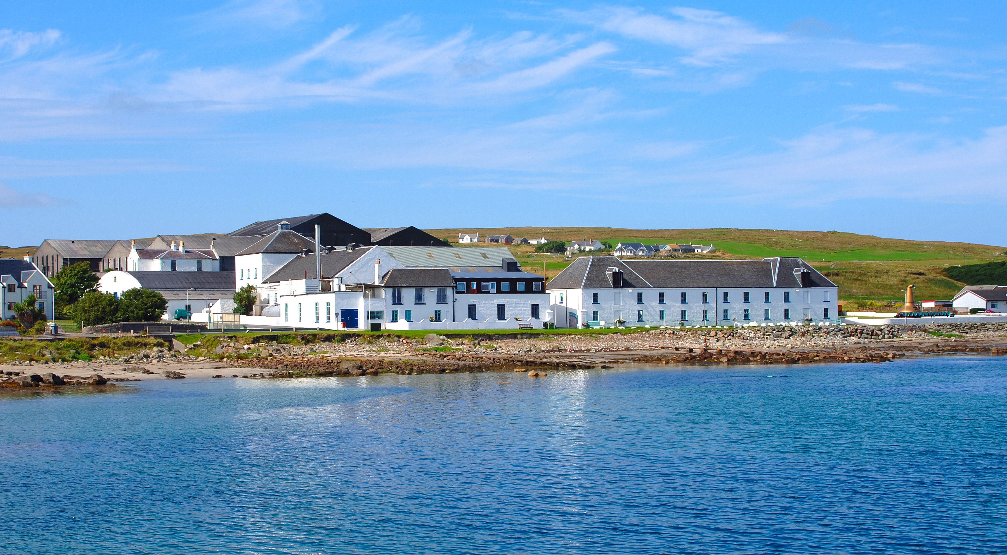
SEVENTEEN DRAMS
bruichladdich Estd. 1881 Isle of islay

Slide 15
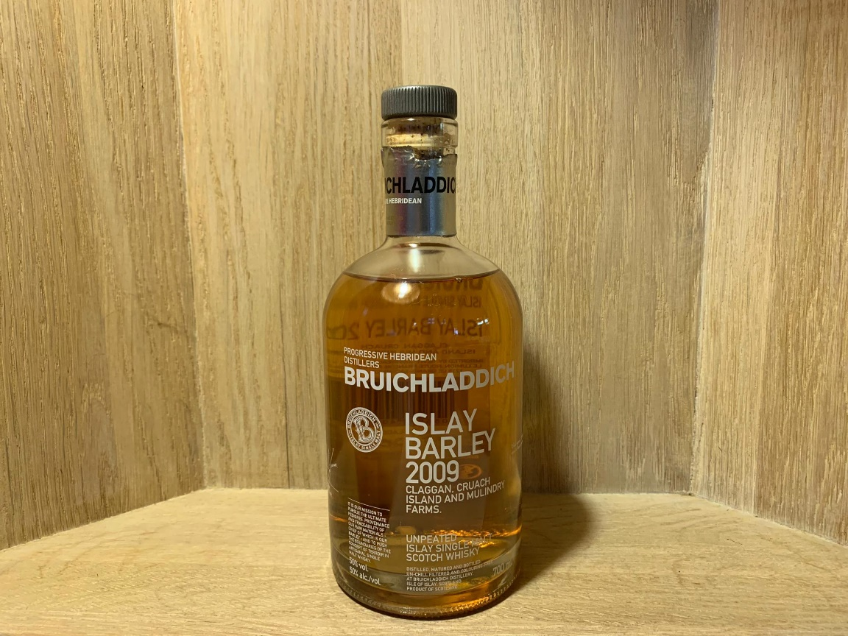
SEVENTEEN DRAMS
Bruichladdich islay barley 2009 50%

Slide 16
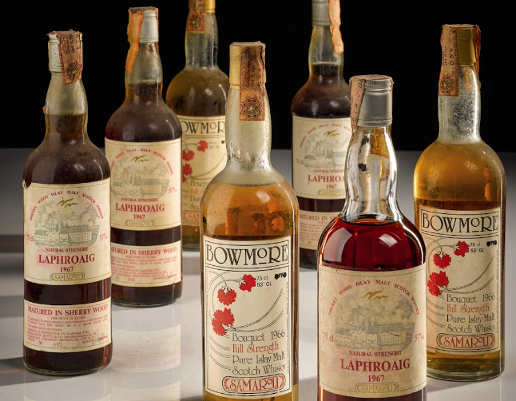
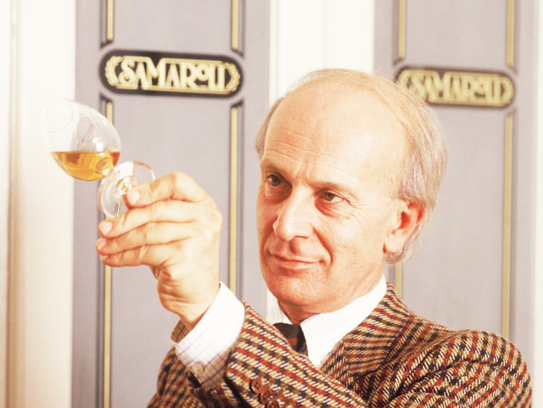


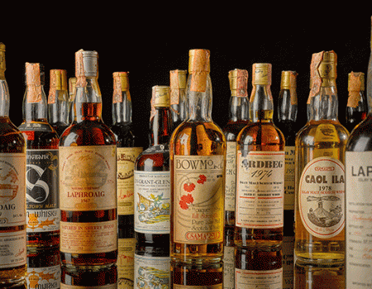
SEVENTEEN DRAMS
samaroli Estd. 1968 Rom, italy

Slide 17
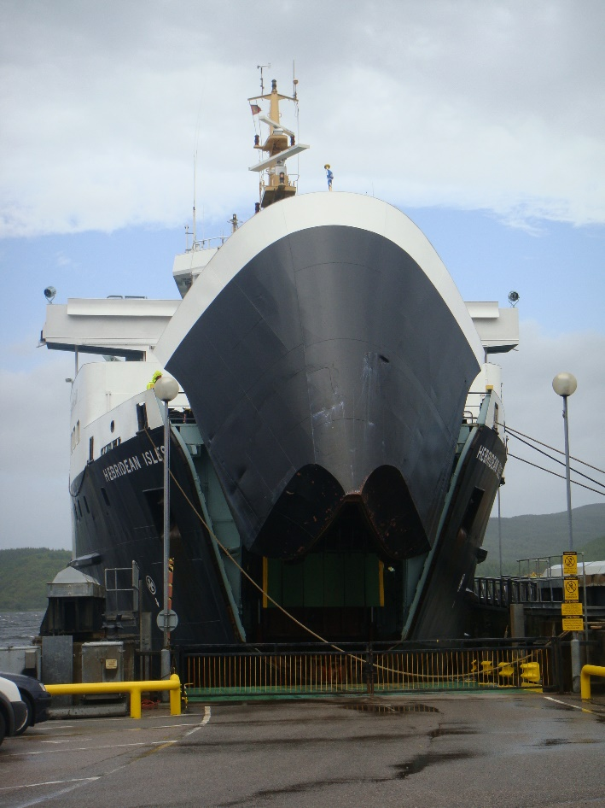
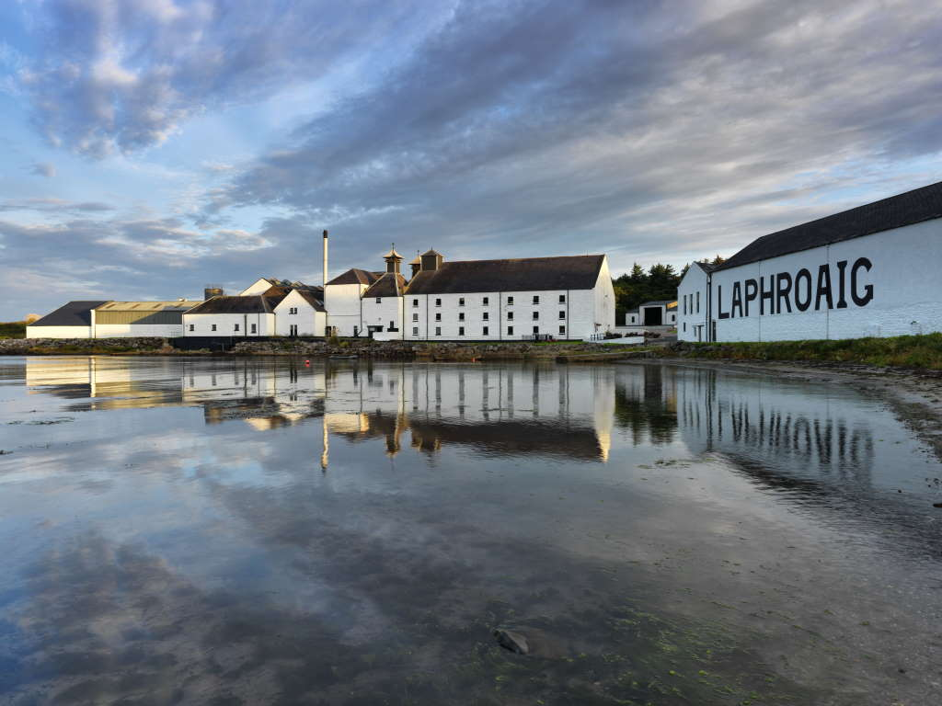
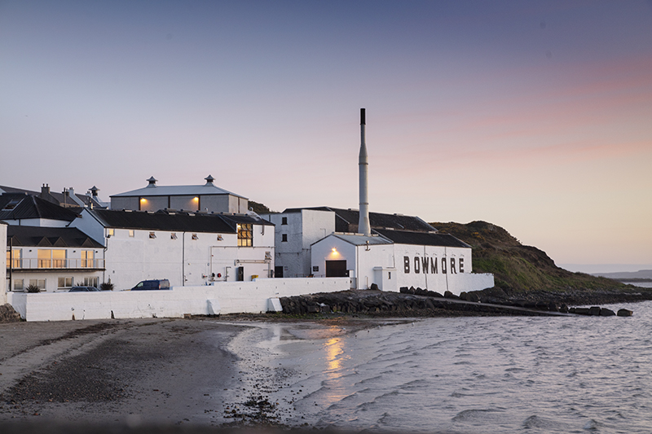
SEVENTEEN DRAMS
Samaroli «ferry to islay»

Slide 18
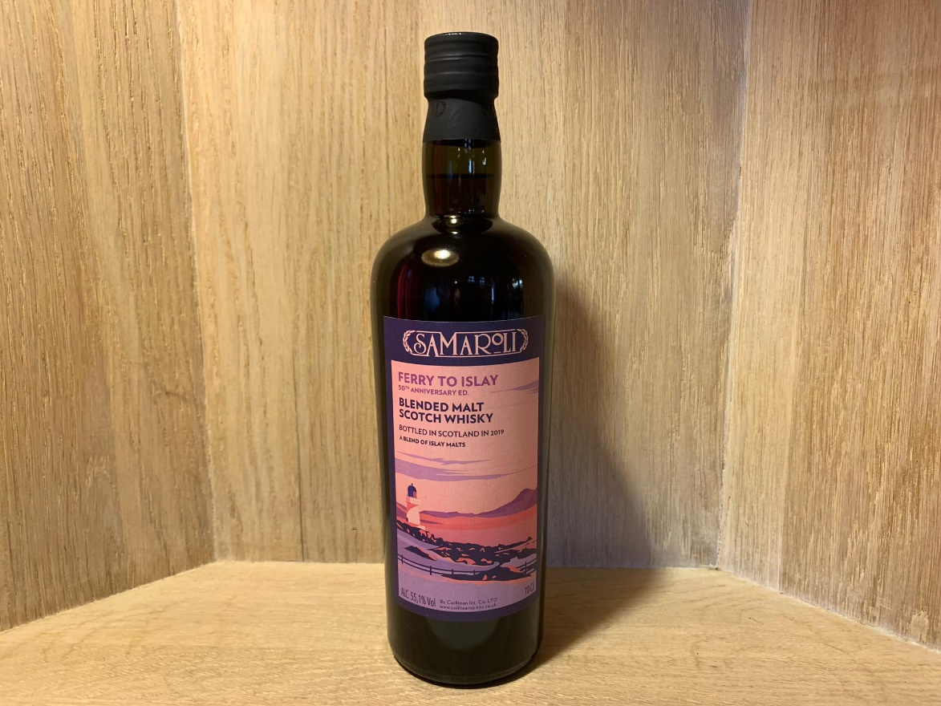
SEVENTEEN DRAMS
Samaroli «ferry to islay» blendet malt laphroaig & Bowmore 1 of 192 bottles 55.1%

